Slide 1
Crystal Imperfections
Dr. Ranjit Kumar
Department of Chemical Engineering
Email: ranjit.kumar@snu.edu.in

Slide 3
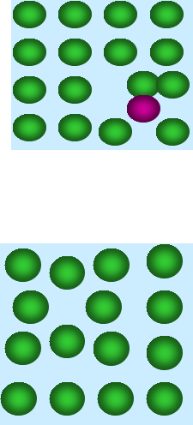
Introduction
• The "right" atoms in "wrong" places.
• "Wrong" atoms in "right" or "wrong" places.
• Missing atoms.

Slide 4
TYPES OF IMPERFECTIONS
• Vacancy atoms
• Interstitial atoms
• Substitutional atoms
Point defects
Line defects
Surface defects
• Dislocations
• Grain Boundaries

Slide 5
POINT DEFECTS

Slide 6
Point Defects
Vacancy
Self-Interstitials
Interstitial Impurity
Substitutional impurity
Frenkel imperfection
Schottky imperfection

Slide 7
Vacancy:
Tensile Stress Fields ?
The simplest of the point defects is a vacancy, or vacant lattice site, one normally occupied but from which an atom is missing. All crystalline solids contain vacancies.

Slide 8
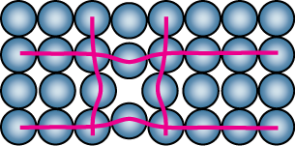
vacant atomic sites in a structure
Vacancy
distortion
of planes

Slide 9
Substitutional Impurity:
Compressive stress fields
Tensile Stress Fields

Slide 10
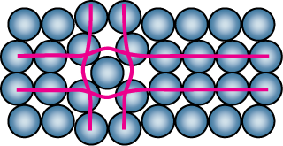
Point Defects in Metals
Self-Interstitials:
Self-interstitial
distortion of planes

Slide 11
Interstitial Impurity
Relative size
Compressive Stress Fields

Slide 12
Frenkel imperfection
vacancy + interstitial site
The Frenkel defect is a vacancy–interstitial combination. A smaller ion, usually a cation, leaves its original lattice site and moves to an interstitial site, leaving a vacancy at its original position. This defect is also known as a dislocation defect. It's more common in ionic solids with large differences in ion size.
Frenkel Defect can be calculated using the following formula:
n = √(NN*)e^{(-ΔH/2RT)}
where,
n= Number of Frenkel defect, N* = Number of occupied positions, N = Number of available positions.
ΔH = Enthalpy formation of one Frenkel defect, R = Gas constant

Slide 13
Schottky imperfection
The Schottky defect is a pair of oppositely charged ion vacancies. This pairing is required in order to maintain local charge neutrality in the compound’s crystal structure.
n_{s} = N e^{(−ΔH/2RT)}
where,
n_{s} = number of Schottky defects per unit volume
N = Number of ions, ΔH = enthalpy of defect formation,
T = absolute temperature (in K), R = gas constant.

Slide 14
Frenkel Defect
The formation of a Frenkel defect involves two main steps:
Ion Displacement: One of the ions, usually a cation, is displaced from its regular lattice site to an interstitial site (a space between lattice points). This displacement can be caused by thermal vibrations or external factors such as radiation.
Creation of Interstitial Ion: The ion that is displaced becomes an interstitial ion, occupying a position between the lattice points. This results in a vacant site at the original lattice position.
Reasons
Size Mismatch - Size difference between the cations and anions.
Highly Polarizable Ions - Ions with high polarizability.
High Coordination Number - Crystals with high coordination numbers.
Ionic Mobility - Ions with higher mobility are more likely to form Frenkel defects.

Slide 15
Schottky Defect
Schottky Defect is a point defect in which an equal number of cations and anions are missing from their lattice sites. In this defect, the ions do not move to interstitial site or replaced by another atoms or ions, they are simply missing or absent from their lattice site, thus creating a defect in the lattice structure. Schottky defect is predominantly found in ionic compounds.
The causes of Schottky Defect :
High degree of ionic compound.
High coordination number of anion.
Small difference between the size of cation and anion.
Schottky defect can be created due to high temperature or radiation
Densely packed structure is also responsible for Schottky defect because of easy vacancy creation

Slide 16
Line Defects
Edge Dislocation
Screw Dislocation

Slide 17
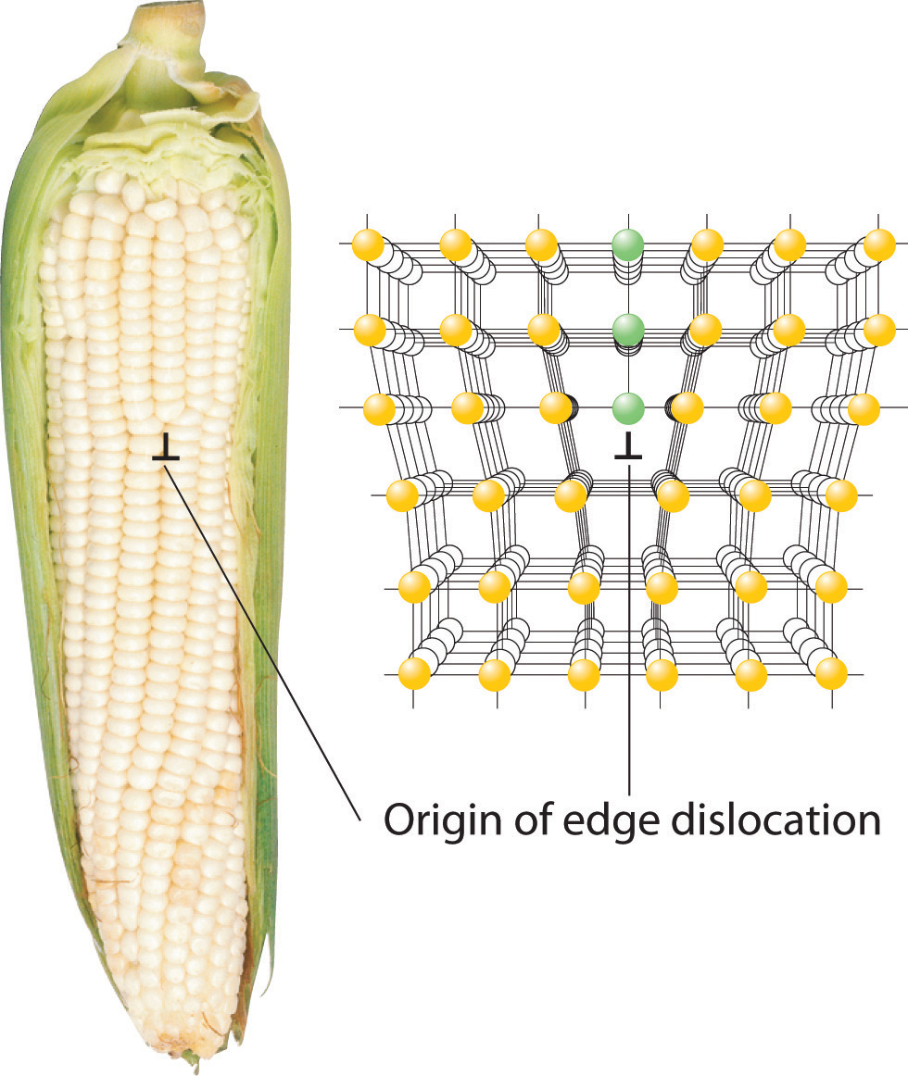

Slide 18
Linear Defects or Dislocations
Linear defects, which are one- dimensional, are associated primarily with mechanical deformation. Linear defects are also known as dislocations. The linear defect is commonly designated by the “inverted T” symbol ( ), which represents the edge of an extra half- plane of atoms.

Slide 19
Burger Vector
The Burgers vector is a difference vector between a closed loop through a crystal lattice with and without a dislocation.
(a) In the perfect crystal, an m x n atomic step loop closes at the starting point. (b) In the region of a dislocation, the same loop does not close, and the closure vector (b) represents the magnitude of the structural defect. For the edge dislocation, the Burgers vector is perpendicular to the dislocation line.

Slide 20
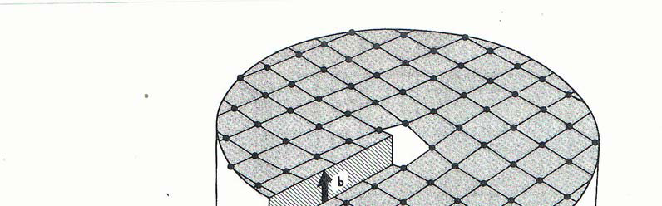
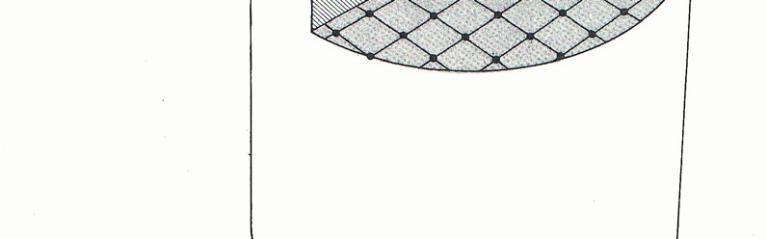
Screw Dislocation
Screw
Dislocation
Slip Planes
Slip Direction
Screw dislocation derives its name from the spiral stacking of crystal planes around the dislocation line. For the screw dislocation, the Burgers vector is parallel to the dislocation line.

Slide 21
Screw Dislocation
Mixed dislocation
This dislocation has both edge and screw character with a single Burgers vector consistent with the pure edge and pure screw regions.
Screw dislocation
The spiral stacking of crystal planes leads to the Burgers vector being parallel to the dislocation line.

Slide 22
Q. Calculate the magnitude of the Burgers vector for (a) α-Fe (BCC) and (b) Al (FCC).
SOLUTION
(a) |b| is merely the repeat distance between adjacent atoms along the highest atomic density direction. For α-Fe, a bcc metal, this distance tends to be along the body diagonal of a unit cell. Fe atoms are in contact along the body diagonal. As a result, the atomic repeat distance is
r = 2R_{Fe}
It is known that R_{Fe} = 0.124 nm
|b| = r = 2(0.124 nm) = 0.248 nm
(b) Similarly, the highest atomic density direction in fcc metals such as Al tends to be along the face diagonal of a unit cell.
|b| = r = 2R_{Al} = 2(0.143 nm)
= 0.286 nm.

Slide 23
Surface Defects: GRAIN BOUNDARIES
Grain boundaries:
• are boundaries between crystals.
• are produced by the solidification process.
• have a change in crystal orientation across them.
• impede dislocation motion.
Schematic
Metal Ingot
The most important planar defect for our consideration occurs at the grain boundary, the region between two adjacent single crystals, or grains. In the most common planar defect, the grains meeting at the boundary have different orientations.

Slide 24
Surface Defects
A twin boundary, separates two crystalline regions that are, structurally, mirror images of each other. This highly symmetrical discontinuity in structure can be produced by deformation (e.g., in bcc and hcp metals) and by annealing (e.g., in fcc metals).

Slide 25
Effect of Grain Boundaries
Grain boundaries affect the properties of metals in several ways:
Electrical resistivity: Grain boundaries increase the electrical resistivity of metals because of their distinct atomic arrangement.
Mechanical properties :
Strength: Grain boundaries restrict dislocation movement, which increases a material's strength. Smaller grains have a higher surface area-to-volume ratio, which means more grain boundaries and a stronger metal.
Ductility: Smaller grains have more grain boundaries, which impede dislocation movement and make the material less ductile.
Corrosion resistance: Grain boundary engineering can improve the corrosion resistance of cold rolled steel.

